Slide 1
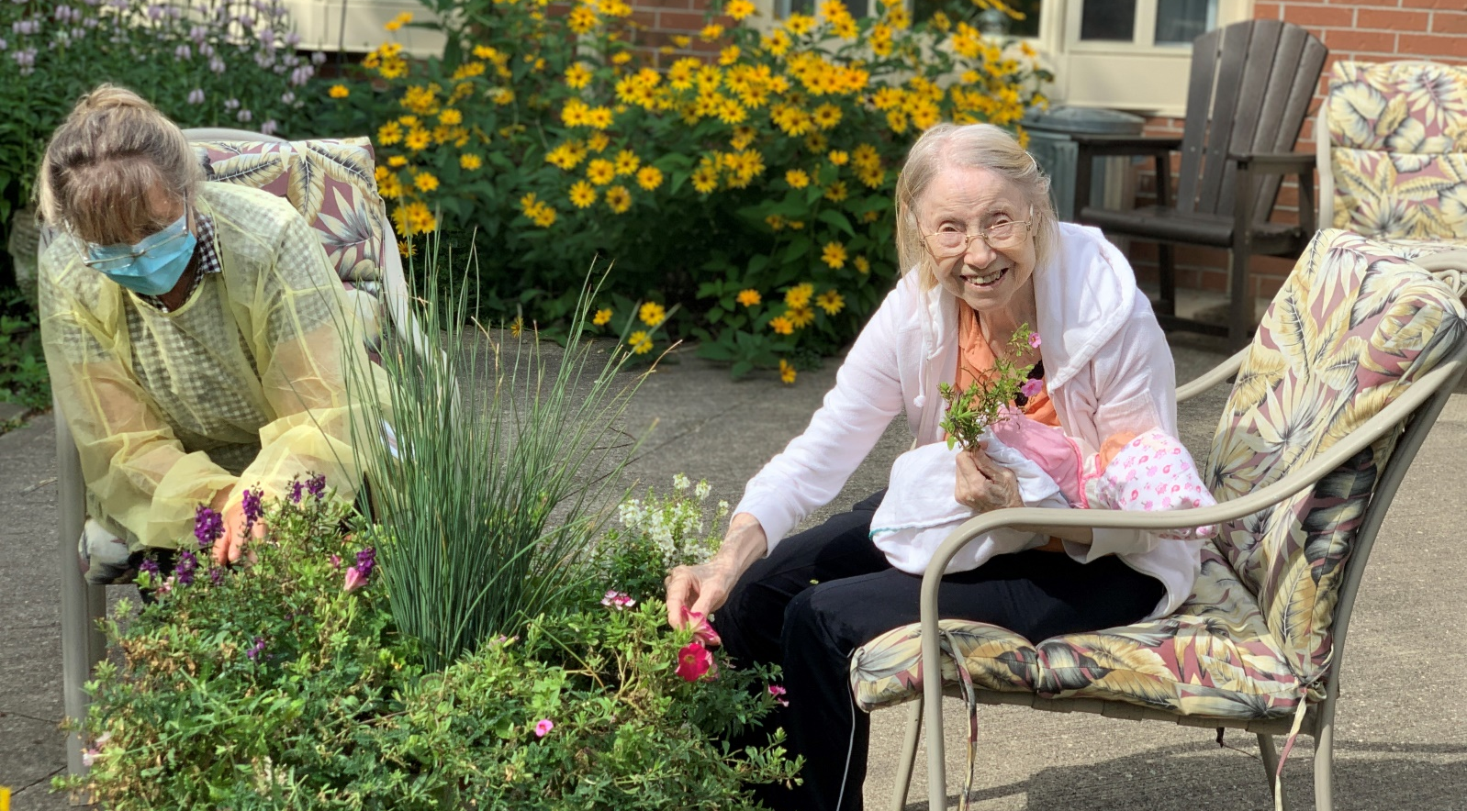
Colour It Connections
Engaging Caregivers in the Vision of Person Centred Care

Slide 2
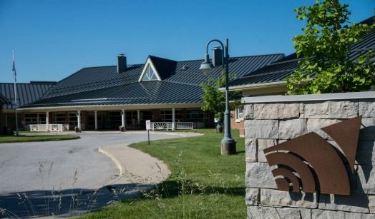
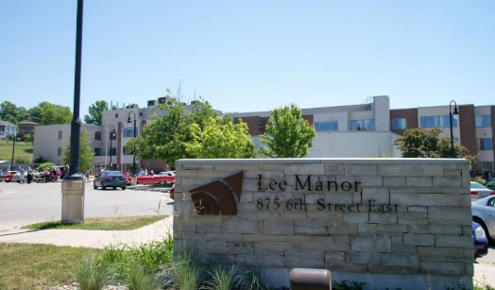
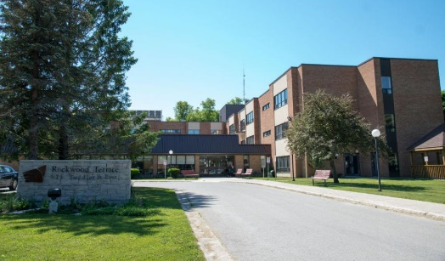
Grey County Long Term Care
Grey Gables
“original” 1903 House of Refuge, rebuilt in 1997
Approximately 25 admissions/year
In 2021, Maple Lane transitioned to offer a Behavioural Support Transition Unit
Lee Manor
Opened in 1973, refurbished in 2006
Joint development by the Lee Estate, City of Owen Sound, County of Grey and Province of Ontario
Approximately 66 admissions/year
Rockwood Terrace
Opened in 1984
Approximately 41 admissions/year
Currently in the redevelopment process. The redevelopment will include the 128-bed long term care home.

Slide 3
Our Culture Change Journey
Engage everyone in a clear vision of the destination.
Ditch FEAR and DREAM large.
Invest in making a positive change.
Notes:
This is the story of a group of people leading, working and living in long term care homes focused on creating a shared purpose, a vision and a promise that could help us during challenges and lead us forward into to the future. A common goal that spoke to our call to serve that drives each of us working in long term care.
It's a story of
Recognizing our fears,
Respecting the individuality of our communities, and
Acknowledging our dreams and making the decision to move forward
All leading us to realize that we could create the changes we dreamed of with an emphasis on this shared purpose.

Slide 4
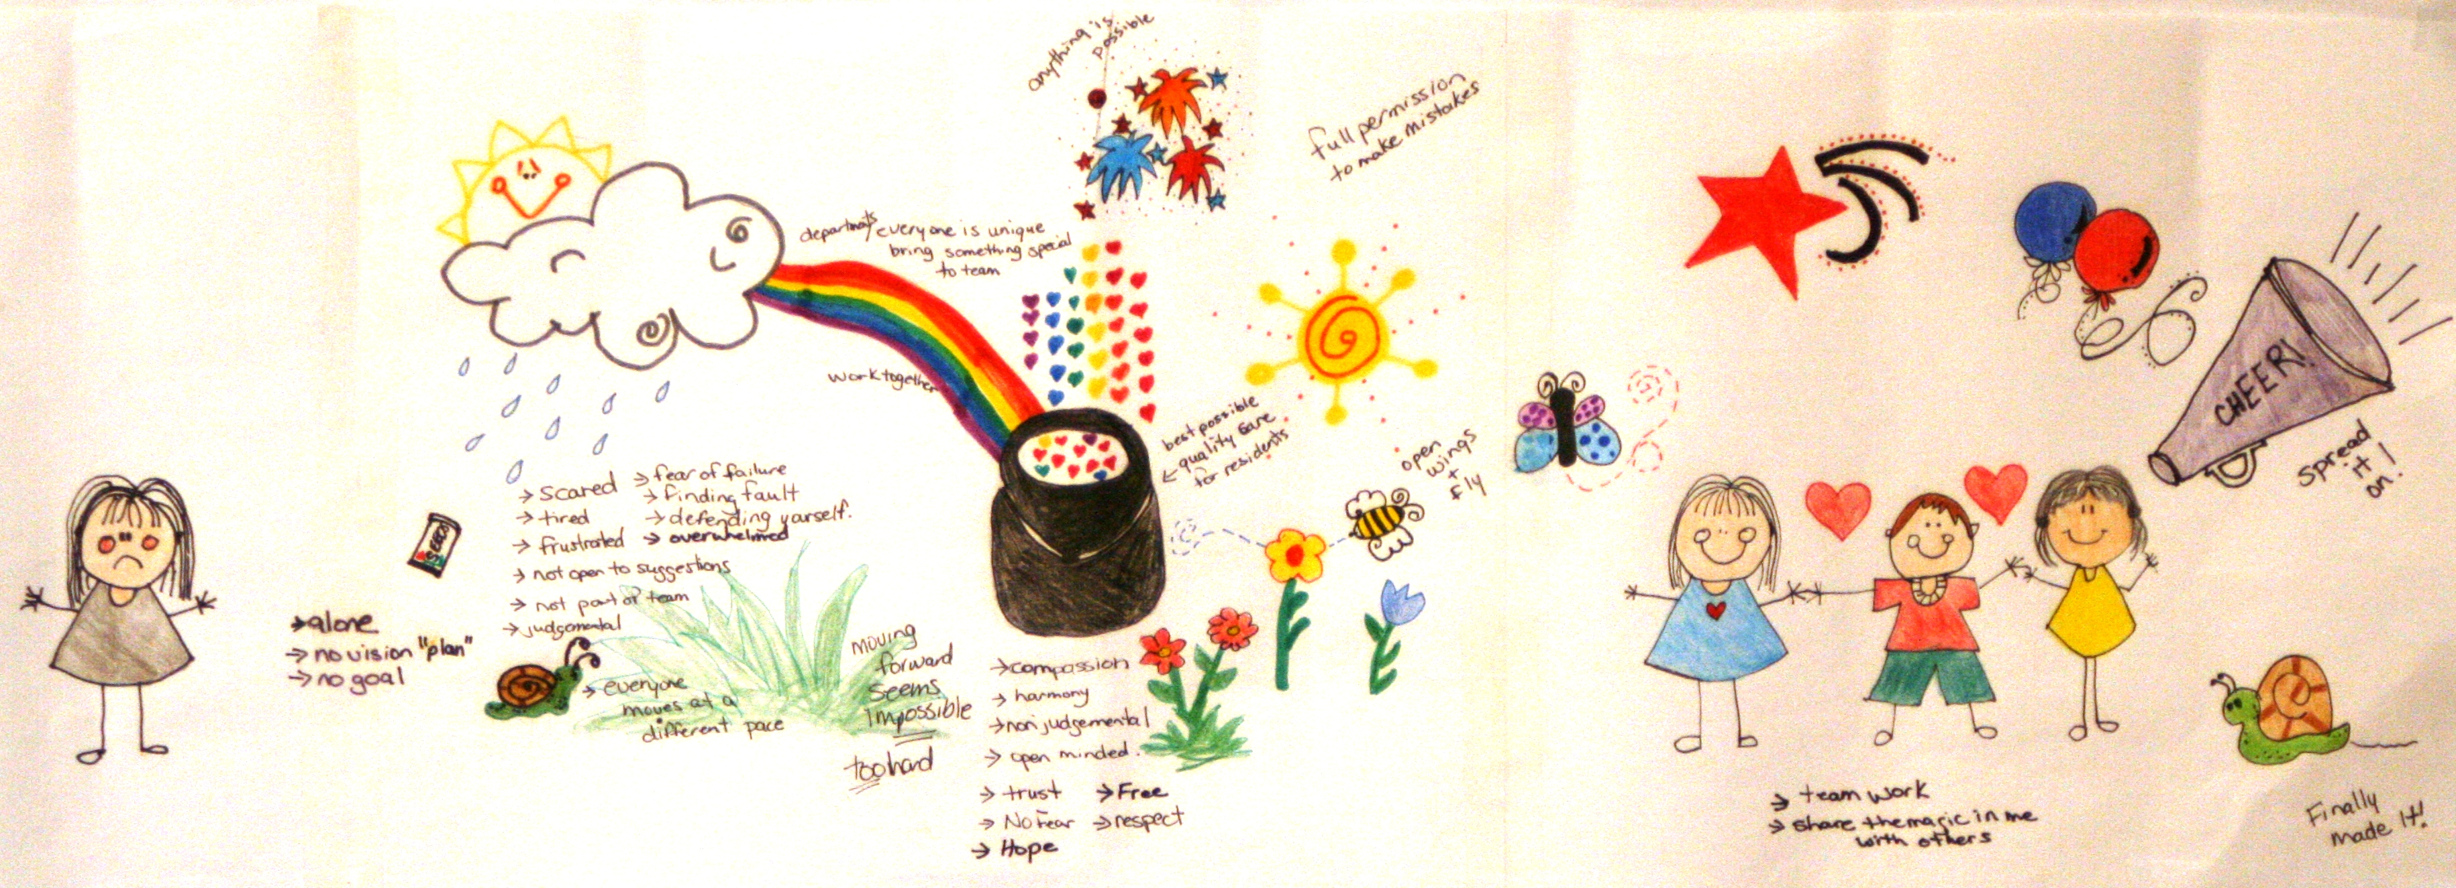
Creating Shared Purpose with intent, investment and unimagined amounts of patience, courage and course corrections + the inspired and inspiring insights from all our teams.
Notes:
how did we get started? Back in 2012, At the time, I was the Executive Director at Grey Gables. We were going through a significant challenge – a significant abuse investigation. We were already talking about what our promise is to our residents, the community and each other, and the challenges just accelerated things. Abuse investigations, difficult press coverage, can be so discouraging, and they can also spark the question “what defines us” does this negative situation define us? So we took the next step and talked about what does define us? What do we want to define us? One of the group activities we did was to draw pictures of what we can imagine, it was through describing each picture that we created the words of the promise…just imagine small groups of staff, residents and families gathering to talk about the future and our vision and I hand out markers and paper…I did get some eye rolling, but all in all everyone humored me and the results were better than I could have even imagined – when groups described their pictures the energy in the room was so great – so hopeful and so exciting. We now had words to describe why we all showed up every day
The first two years we continued to talk about colour it, our words for resident centred care, this shared purpose…people started using that language in circle of care, care pans, care conferences

Slide 5
Helping You to Colour Your Life Your Way!
Community
Opportunity
Leadership
Organizational Quality & Safety
U are the Centre of All We Do
Relationships
Integrity
Together for Tomorrow
Notes:
When the groups described their pictures, many words kept coming up again and again. Those are the words that make up our Colour It Your Way Promise/vision - our shared purpose

Slide 6
Creating a shared purpose, how it started and how it's going…
A Promise is a Promise - how we learned to create shared purpose.
The challenge and heartbreak and gigantic wins of knowing that “culture is how you behave”.
What are the expectations …Creating the standard, expanding the standard.
Becoming Leaders who can inspire orchestrate and facilitate the evolution of Colour It.
Colouring it forward, learnings, challenges, next steps.
Notes:
In the beginning, creating this common goal/shared purpose was setting the foundation of who we wanted to be and how we wanted to behave, given the challenges we were facing. Colour It Your Way, were our words on how we wanted to provide care and service, to be resident centred. It evolved over the years to be our shared purpose in not only our care and service to our residents, but also to our relationships with our staff and finally, our relationships with our family members, essential caregivers. In the time I have with you today, I'll share some of our stories and learnings as we expanded our colour it vision to include and engage with our family members.

Slide 7
The challenge, heartbreak and gigantic wins when you know your purpose and that ‘culture is how you behave’
Leadership
Colour it wins
Working in a world of urgency
MLTC command and control culture
Notes:
So, we had our Promise, we had the words that describe and clarify that commitment to person centred care. We’re well on our way, right!? Yes and No. We knew people were engaged, because staff started to report inappropriate actions and words towards the residents. It wasn’t what I was expecting, but it showed they were engaged and they were challenging me to put my money where my mouth was – it was a really hard time, but it was when we had to respond, react and behave – The hardest part was being vulnerable to know that the bad things happen to good people – say it out loud, and then move to be better. Long term care can be fraught with urgency and stressful emotions – it can feel like a simmering pot for everyone, residents, families, staff. Our shared purpose helps me to take a breath and remember not to be hooked by urgency, but to let Colour It promise guide our response.

Slide 8
Change is not the Goal The Goal is the Goal
The absolute necessity of being clear on the standard
Working to have everyone be able to put into their practices what Colour It Your Way looks like, sounds like, tastes like, cares like and acts like.
Notes:
this is an investment of time and money – keeping to the story theme…it’s creating the plot, the setting, the characters, the conflict and the resolution. Having a shared and understood purpose doesn’t happen by itself, it happens with intentional leadership. Coaching, reflective practice… not a place to get to, but a lens to look through – What’s the colour it lens on any situation? i.e. what does person centred admission look like? Through team member discussion we now talk about a “colour it move in’ Over the years, it was easy to see that this person centred approach could apply to everyone, the staff and families. A reminder to us that This isn't a one and done exercise. Every new challenge or opportunity, is a chance to use the vision as a guide to the next steps. The pandemic was a catalyst, and while I'll always be sad and heavy hearted on the terrible and horrific impact COVID 19 had on people in long term care, I can see some good that has come from shining a light on what desperately needed to be changed and the many opportunities to build our care teams to include the people that care the most about our residents.

Slide 9
Colour It - Community
Colour It Connect Program
Virtual Family Meetings
Designated Care Partner Program
Notes:
Colour It allowed us to step back and reflect on who we really are in the early days of the pandemic – everyone was afraid and worried, response seemed always a little too late, things shifted to command and control, iron ring. We didn't always get it right, but we always used Colour It Your Way to guide us. When the doors were locked, residents were being isolated, families and friends not able to come in, everyone desperate for information, we knew there had to be a way through, even if it was difficult. Staff noticing the residents failing...
Knew we had to engage families to be part of the problem solving:
Virtual Family Meetings
Colour It Connect – communications, IT, staff, technology
DCP
During the pandemic, virtual family meeting were held regularly, we have now moved to quarterly meeting post pandemic

Slide 10
Colour It Engagement
Reached out for support from all team members in every department including, Medical Director, Family and Resident councils, residents and family members.
The program was presented to staff through huddles; opportunity for questions, discussion and feedback.
Draft policy/program was reviewed by all partners:
Public Health
Residents
Families/caregiver
Notes:
when residents couldn’t have visitors we knew there had to be another way. Colour It was the foundation for the question “what are we going to do?” allowed us to build the designated care partner program that reflected our promise – allowing residents to have their caregivers safely supporting them at the bedside, even during a lockdown and an outbreak.
With all new programs, we know that engagement from all parties is a crucial element. We wanted feedback from our residents, families, team members, and our Medical Directors. Connecting with these groups provided an opportunity to answer questions, listen to concerns and gathered their input.
Once all feedback was reviewed, our draft policy was presented to our partners at our local Public Health Unit, and to our resident, and family councils for their review and approval.

Slide 11
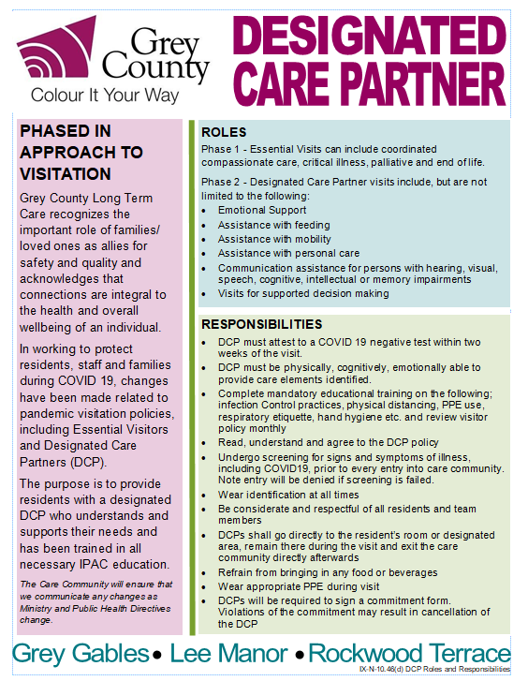
What did we learn?
Safety and education.
Value in the DCP Role
What are the roles and responsibilities of the DCP and team members
Acknowledge DCPs as an integral part to resident’s health and overall wellbeing
Colour It partnership
Assigning a Lead/Champion
Communication
(transparent/consistent)
Compliance Process and support
Notes:
What did we learn from our team engagement?
Increasing the number of people in our homes was a concern for staff. We developed an accessible DCP education program, covering infection prevention and control measures that would provide the DCPs with the necessary training to ensure all guidelines were followed. This included offering education in 3 ways; online learning, a hard copy version and in person training when necessary.
We also used the train the trainer approach, and our IPAC team educated our screeners so they could provide refreshers to our DCPs.
Our team recognized the value in the DCPs role, as the DCPs would be providing support in many different ways such as:
Emotional & Physical needs
Nutritional intake
Communication
Wandering and behaviours
Personal Care
Depression
Mobility
Participation, etc.
We also learned that it was important for our staff and DCPs to be part of ONE Colour It Care Team, a team working together to achieve a common goal.
Over the past two years, we have provided consistent communication to residents, families, DCPs and staff. We provided regular updates through virtual town halls, emails, newsletters, monthly refreshers, and this continues today.
To ensure all guidelines were followed, we included our compliance process within our DCP policy and provided additional support when needed.
The question we always asked ourselves is “How do we colour it for our residents and how do we get to Yes?

Slide 13
In July 2021 Kate Ducak and Christine Sheppard presented their final report outlining their analysis of the data collected.
The report included the DCP demographics, impact, role, experience and the recommendations.
Notes:
Jen - In July 2021 Kate and Christine presented their final report outlining their analysis of the data collected. We’ve attached a link to the full report with this presentation.

Slide 14
Feedback
98% of DCPs felt respected by staff
77% of DCPs felt supported by staff
73% of DCPs felt staff regularly addressed their concerns about their loved ones
92% of staff felt DCPs were effective members of the care team
84% of staff relied on DCPs for information about their loved one
Notes:
The feedback was so great and really helped to inspire and motivate all team members on the value and importance of caregivers in the lives of residents living in ltc.

Slide 15
Feedback
70% of staff involved DCPs in care planning
92% of DCPs felt their training was informative
89% of DCPs knew who to talk to if they had questions
89% of DCPs felt they received regular updates about the program and change in policies
90% of DCPs felt the IPAC procedures would keep them and their loved ones safe
70% of staff felt the DCPs were adequately trained to safely re-enter the home
1/3 of staff felt DCPs were consistently following IPAC guidelines
Notes:
Jen - Many times over these past months, some of which, as you know, were very dark and very stressful, we were reminded first hand how lucky we were to have caregivers safely in the homes at the bedside, supporting not just residents, but also staff. I maintain, that if we are fueled by gratitude alone, the thanks and words of support from DCPs and residents will get us through. And sustain us

Slide 16
DCP’s Role during Outbreaks
In the past, all general visitors were restricted during outbreaks.
IPAC education is part of the initial onboarding process and is also included in monthly communication to our DCPs. These resources prepare our DCPs for additional outbreak protocols.
Our three homes experienced COVID-19 Outbreaks during the 4th wave. During the outbreak, our DCPs provided additional support (ADLs and meals) to the residents and staff which was invaluable. Once again proving, that the role of the DCP is a crucial part of our care team.
Today’s outbreak guidelines:
Limited to one DCP per resident visit.
DCPs were provided N95 masks and additional PPE as required.
Follow all testing requirements.
Screeners and IPAC leads provided hands on training for donning and doffing.
Notes:
Hearing their stories are still emotional for me today and really tell the story of how real and raw this pandemic has been for each of us in a different way. and that was how DCPs felt without our homes facing any significant covid outbreaks. We weren’t fully spared though and in the fifth wave of covid – the omicron variant over Dec. to February, all three of our homes experienced significant covid outbreaks. We had many covid positive residents and staff, causing significant staffing shortages and when we asked, the DCPs stepped up and provided all kinds of support – they adjusted their visiting time to be around meals, they helped with delivering trays, assisting their loved one with ADLs, cleaning of high touch surfaces, emotional support, cheerleading and so much more.

Slide 17
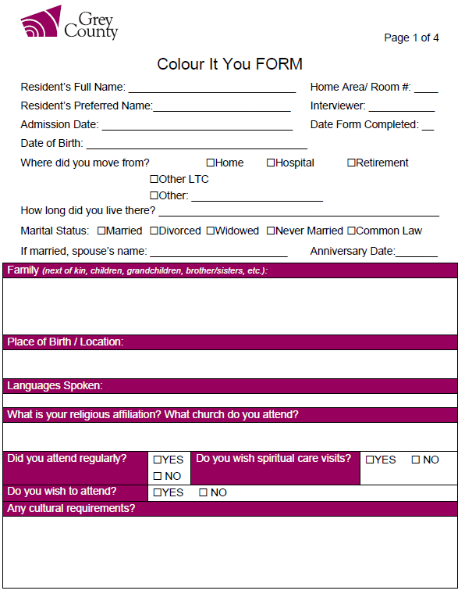
Colour It – Together
Move-In Process
Introduction to the Designated Care Partner Program
Care Conference
Annual Family & Resident Experience Surveys
Resident Recreation Survey

Slide 19
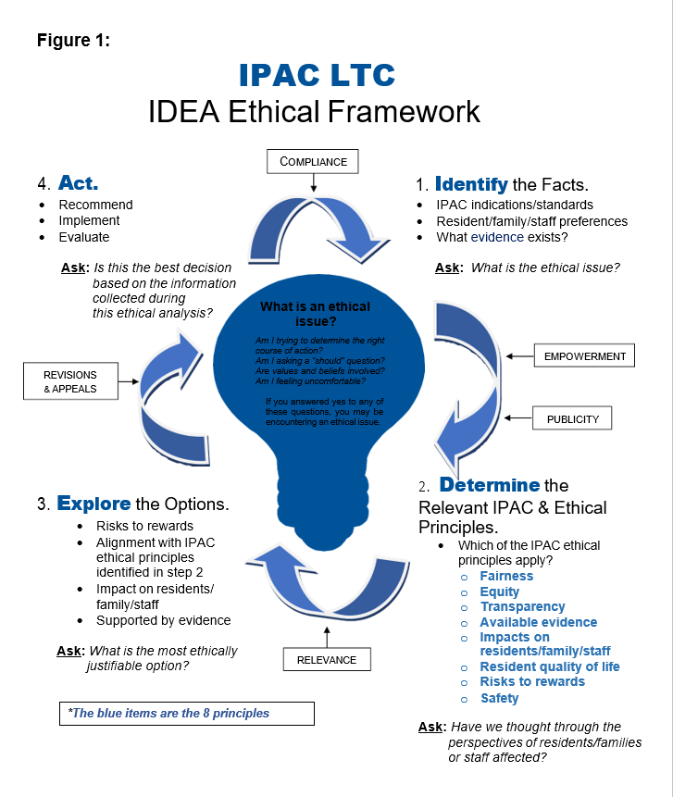
Engagement/Co-Design
Facilitated by the Infection Prevention & Control and Wellness Leads, each home brought together residents, families, staff, and leadership to determine the most ethically justifiable option for masking using an Infection Prevention and Control (IPAC) ethical framework.
Identify the Facts
Determine the Relevant IPAC & Ethical Principles
Explore the Options
Act
Notes:
All three Grey County homes met to ask the question if universal masking should return as we head into another atypical fall season.
Grey County adopted the IPAC LTC-IDEA Ethical Decision-Making Framework created by Sunnnybrook Health Sciences Centre, and the North Toronto Ontario Health Team (adapted from the Trillium Health Partners: IDEA- Ethical Decision-Making Framework). The IDEA framework has four steps:
1. Identify the Facts
2. Determine the Relevant IPAC & Ethical Principles
3. Explore the Options
4. Act

Slide 20
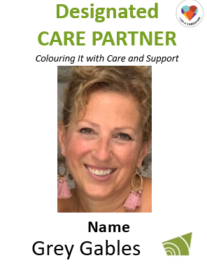
Partners in a Shared Purpose
An addition to our Colour It Care Team:
Member of family council
Volunteer
Communications
Training and Education
Name Badge design and use
Experience Surveys
Virtual Meetings
Participation in several research studies
Promotional Videos and presentations
Advisory Committees
Appreciation Events
Notes:
And so, as we all shift our focus from pandemic response, to wellness and recovery, we ask ourselves, How does the DCP program change from a response to visiting restrictions, to a program and role that is part of every day life in ltc? Our Colour It team believes that DCPs are an important part of the care team, a voice to support their loved one, to help us create truly person centred care. And in the words of one DCP “it’s magic, it’s connection, it’s life and it’s love – and that’s the value of a DCP program”… So we are actively looking for ways to adapt what we’ve always done, to include DCPs. We’d love to hear how you are including caregivers in day to day operations – share your ideas and experiences in the chat box.
Part of the admission process, care conferences & participate on family council.
Included in the day-to-day operations.
Internal communications are now addressed to staff and Designated Care Partners.
Annual resident and family experience surveys
DCPs are now part of data collection.
Part of future planning

Slide 21
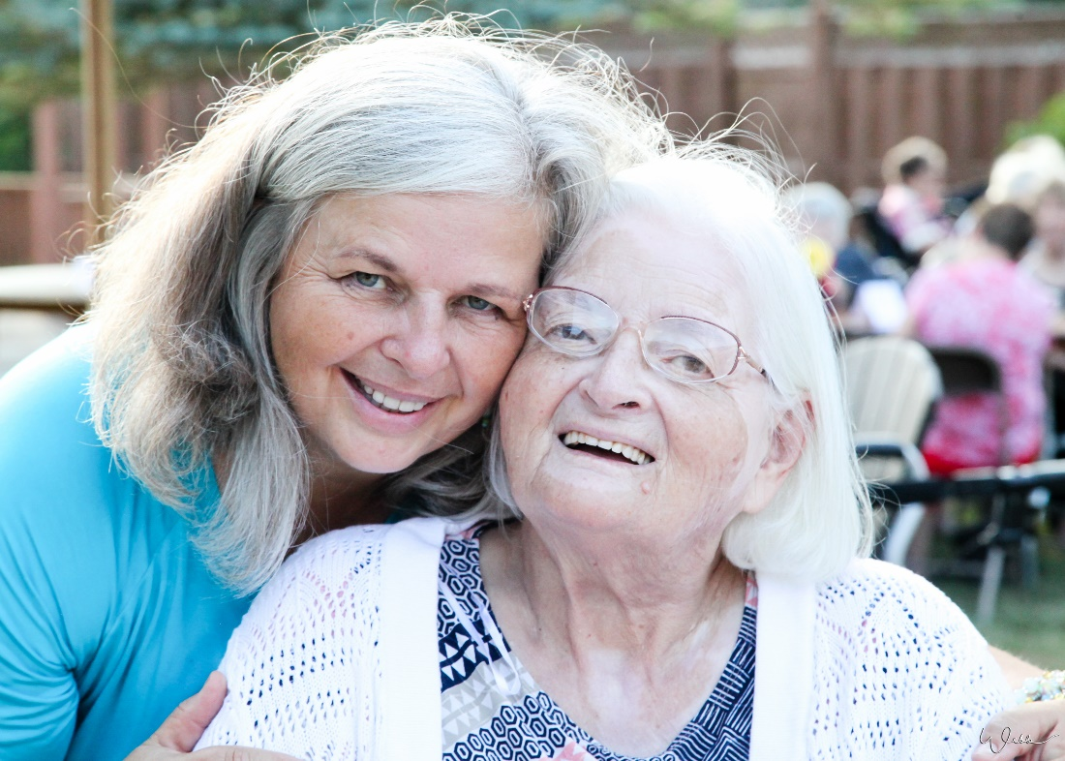
Colour It into Tomorrow
Community, Opportunity, Leadership, Organizational Quality & Safety,
U are the Centre of All We Do, Relationships, Integrity, Together for Tomorrow
Notes:
Still an evolution - co-design, not cookie cutter, ongoing process, culture change, person centred care, part of the team
As Director – it’s my job as the leader to hold the standard, I’m the keeper of the vision and hold accountability – helped me feel better about the big challenges…
It’s Tempting to get sucked into responding to the new act and regs with fear and worry – but when I shift my perspective I can see that my accountability is to colour it the residents and by doing so we will meet the regulations – My job is not to meet the regulations but to colour it for the residents and the team members in all that we do.
LTC sense of urgency – media, inspection and compliance, legislation, complaints etc , etc. Easy to focus on those things, looking for the problems.
Truth is we’ll see and find the problems no matter what our focus is – so shift to positive, focus on how we want to behave, be seen, look for and notice the positive – examples that live up to the promise and the vision – remembering that everyone is doing their best…this is what leads us towards a transformed ltc in our future. Use your mission, vision or promise, if it doesn’t serve you, talk with teams, residents, families on how to change it, make it live. It will ground you and guide you.

Slide 22
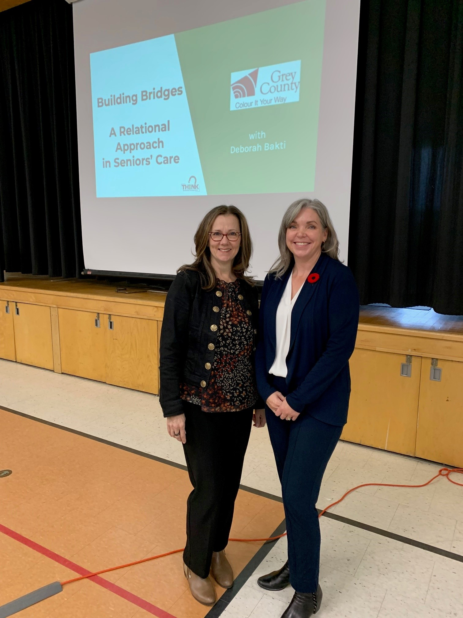
Managing the Emotional Journey Supporting Each Other Through Long Term Care
Family Councils hosted our first virtual family event with guest speaker, Deborah Bakti,
Leadership Session focused on relationships "Bridging the Gap – A Relational Approach in Seniors Care
Take The Lead Program – professional growth for front line team members as champions
Notes:
In June, our three family councils hosted our first virtual family event with guest speaker, Deborah Bakti, author of “Now What? Managing the Emotional Journey of Long-Term Care”. Deborah shared her many personal experiences as a resident’s wife and daughter with her industry insight to provide a framework for managing this major life change.
How to manage the Long-Term Care journey with more ease and grace, and less guilt and anxiety.
The 7 A’s of this emotional journey.
Strategies to manage your energy effectively.
How to recognize and respond to your grief.

Slide 23
“Colour It”…… into tomorrow
Accreditation Canada
Family Council
Cultural Diversity
Human Resources
Professional Growth Opportunities
Collaborative Work
Colour It Your Way information sessions
Notes:
Reminder:
What we pay attention to matters. What we appreciate appreciates…When feeling discouraged, one exercise to do is to spend a week writing down things you see that align with the promise…

